Slide 1




DIGITAL LITERACY
SKILLS
INTERMEDIATE USERS

Slide 2
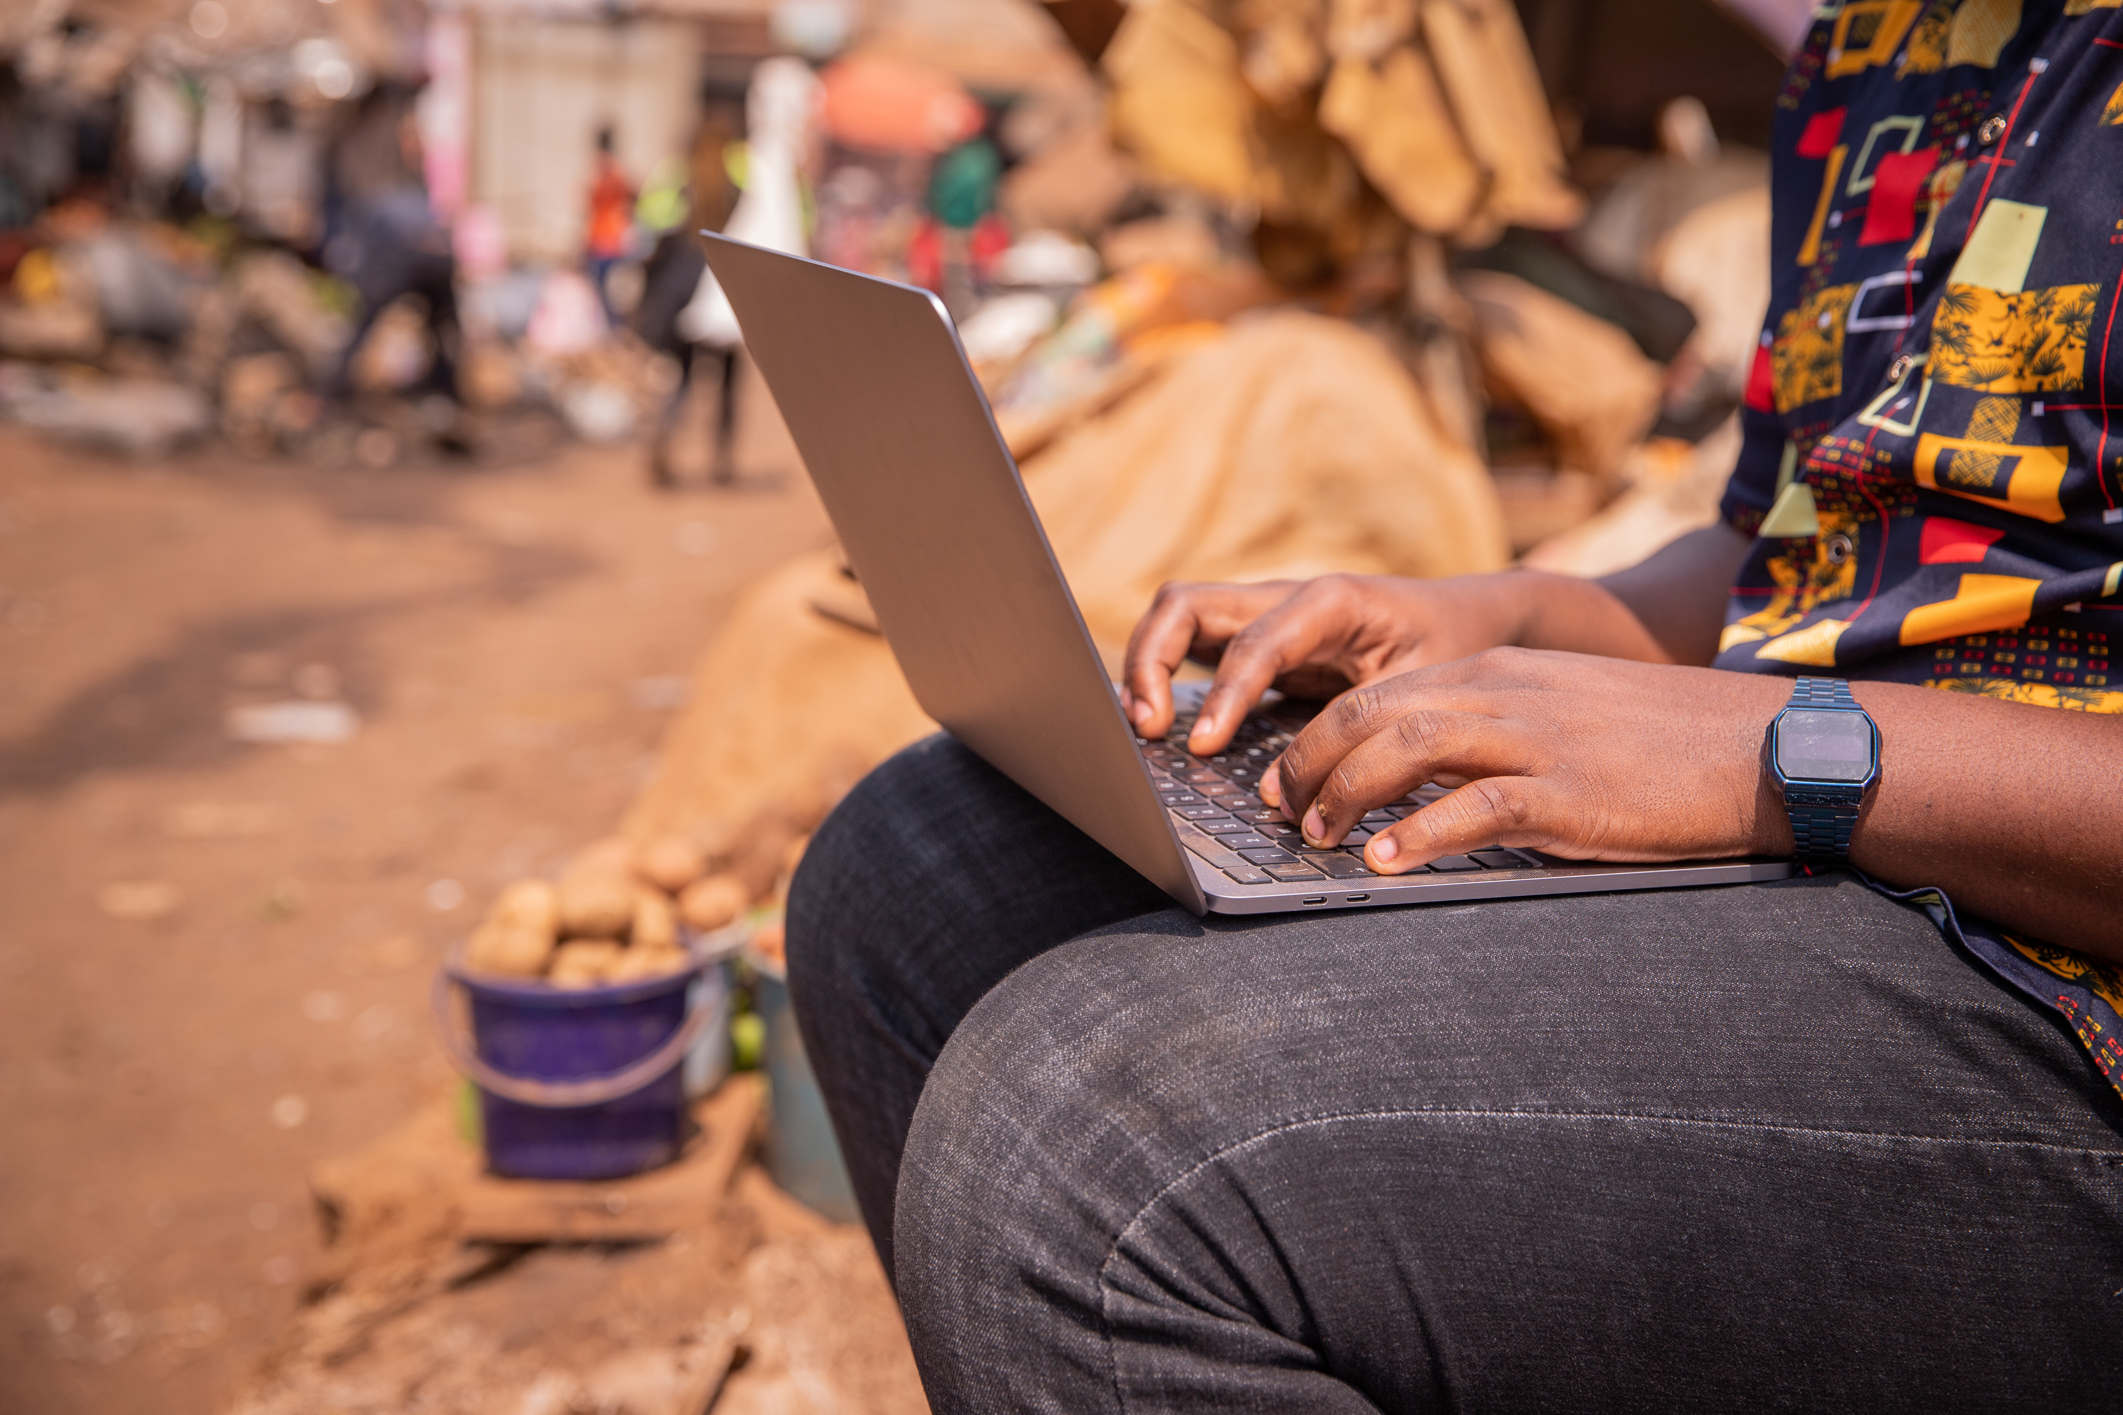
Module 3
Communication
and collaboration

Slide 3

5
Unit 5: Netiquette

Slide 4
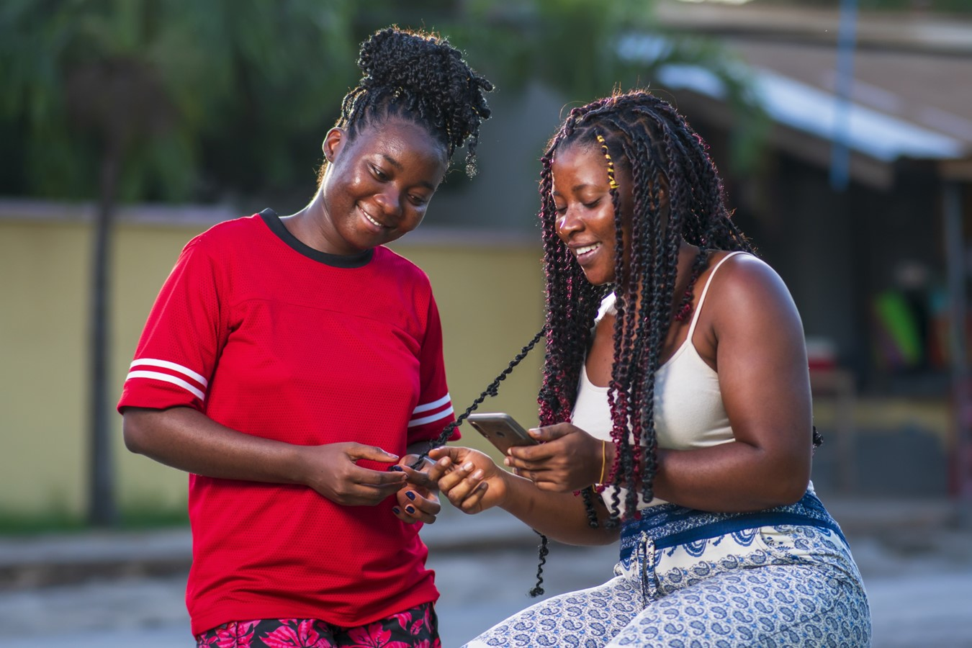
What does netiquette mean?
Netiquette is the online equivalent of etiquette. It is a way of behaving that respects and upholds the dignity and humanity of the people you are interacting with online.

Slide 5
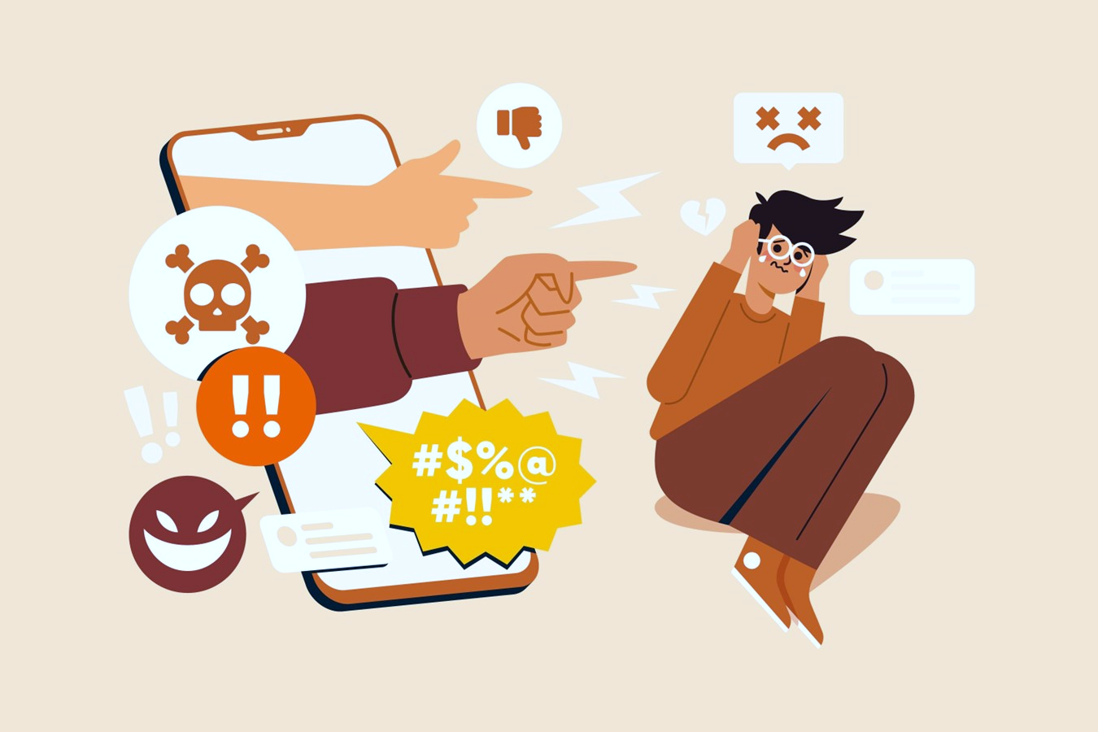
What to avoid when applying netiquette
Bad netiquette includes all online behaviours that are disrespectful towards others.

Slide 6
What to avoid when applying netiquette
Disrespecting intellectual property: Sharing content of others without citing the source.
Not respecting other people's opinions: Adopting hostile and insulting attitudes.
Expressing ourselves in a disrespectful way: When writing be aware of how you write and how you express yourself and your ideas.
Disrespecting the privacy of others: Never share sensitive data without the other person's permission.

Slide 7
Skills to practise
Use digital technologies to interact about behavioural norms.
Work in a group and create a list of 10 true/false questions about acceptable or unacceptable online behaviour.
Use Google Forms or SurveyMonkey (https://help.surveymonkey.com/en/create/creating-a-survey/) to create a survey.
Create the survey and send it to your classmates to respond.

Slide 8
All back covers should include
contact information of the section
producing the work.
© United Nations Children’s Fund (UNICEF) [month and year of publication]

